Slide 1
Lecture 17
ANNOUNCEMENTS
Wed. discussion section moved (again) to 6-7PM in 293 Cory
OUTLINE
NMOSFET in ON state (cont’d)
  Body effect
  Channel-length modulation
  Velocity saturation
NMOSFET in OFF state
MOSFET models
PMOSFET
Reading: Finish Chapter 6

Slide 2
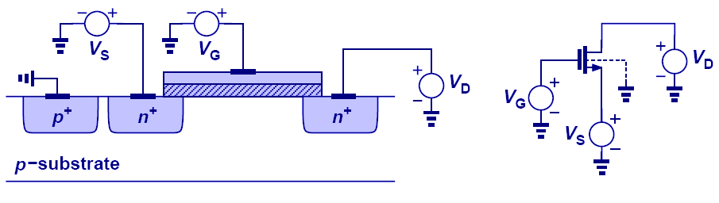
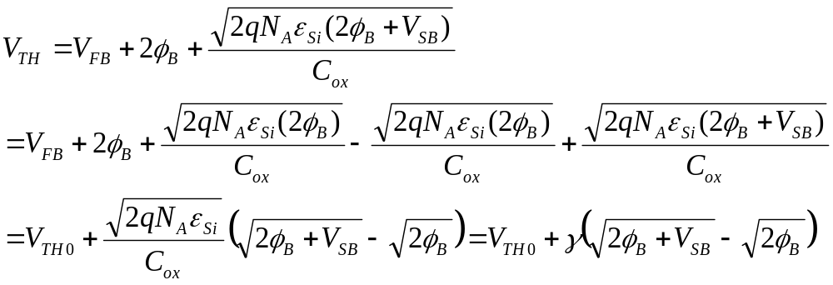
The Body Effect
V_{TH} is increased by reverse-biasing the body-source PN junction:
γ is the body effect parameter.

Slide 3
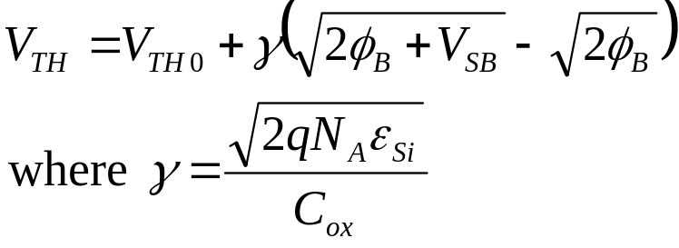
Body Effect Example

Slide 4
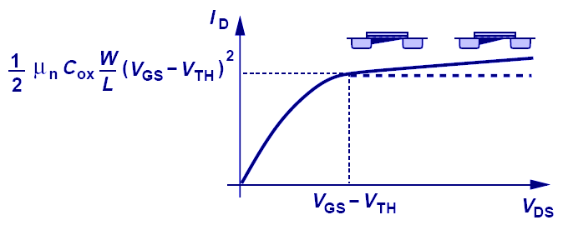

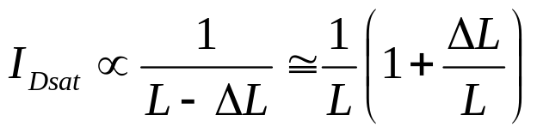
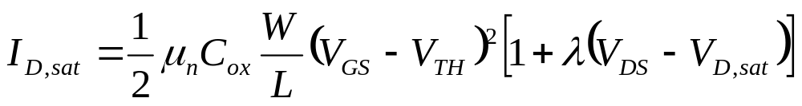
Channel-Length Modulation
The pinch-off point moves toward the source as V_{DS} increases.
The length of the inversion-layer channel becomes shorter with increasing V_{DS}.
I_{D} increases (slightly) with increasing V_{DS} in the saturation region of operation.
λ is the channel length modulation coefficient.

Slide 5
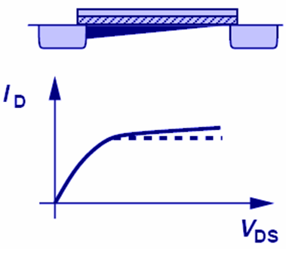
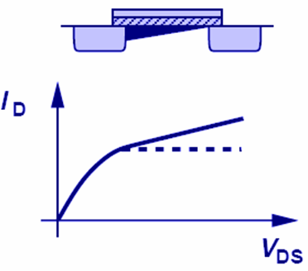
λ and L
The effect of channel-length modulation is less for a long-channel MOSFET than for a short-channel MOSFET.

Slide 6

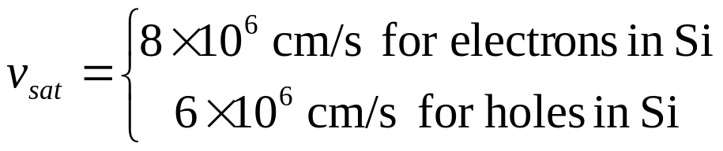

Velocity Saturation
In state-of-the-art MOSFETs, the channel is very short (<0.1μm); hence the lateral electric field is very high and carrier drift velocities can reach their saturation levels.
  The electric field magnitude at which the carrier velocity saturates is E_{sat}.

Slide 7
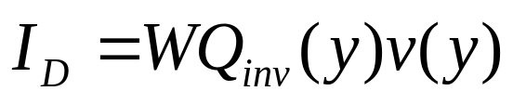
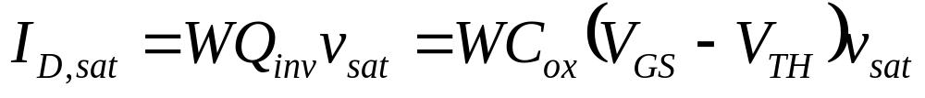
Impact of Velocity Saturation
Recall that
If V_{DS} > E_{sat}×L, the carrier velocity will saturate and hence the drain current will saturate:
  I_{D,sat} is proportional to V_{GS}–V_{TH} rather than (V_{GS} – V_{TH})²
  I_{D,sat} is not dependent on L
  I_{D,sat} is dependent on W

Slide 8
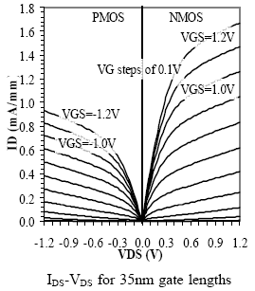
Short-Channel MOSFET I_{D}-V_{DS}
P. Bai et al. (Intel Corp.),
Int’l Electron Devices Meeting, 2004.
I_{D,sat} is proportional to V_{GS}-V_{TH} rather than (V_{GS}-V_{TH})²
V_{D,sat} is smaller than V_{GS}-V_{TH}
Channel-length modulation is apparent (?)

Slide 9
Drain Induced Barrier Lowering (DIBL)
In a short-channel MOSFET, the source & drain regions each “support” a significant fraction of the total channel depletion charge Q_{dep}×W×L
  → V_{TH} is lower than for a long-channel MOSFET
As the drain voltage increases, the reverse bias on the body-drain PN junction increases, and hence the drain depletion region widens.
  V_{TH} decreases with increasing drain bias.
(The barrier to carrier diffusion from the source into the channel is reduced.)
    → I_{D} increases with increasing drain bias.

Slide 10
NMOSFET in OFF State
We had previously assumed that there is no channel current when V_{GS} < V_{TH}. This is incorrect!
As V_{GS} is reduced (toward 0 V) below V_{TH}, the potential barrier to carrier diffusion from the source into the channel is increased. I_{D} becomes limited by carrier diffusion into the channel, rather than by carrier drift through the channel.
(This is similar to the case of a PN junction diode!)
  I_{D} varies exponentially with the potential barrier height at the source, which varies directly with the channel potential.

Slide 11
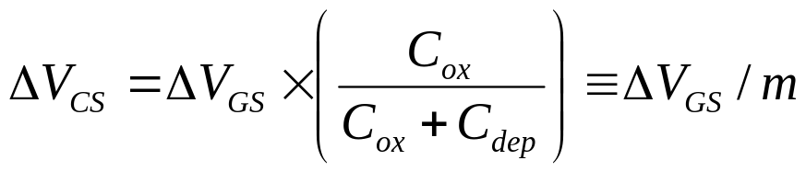
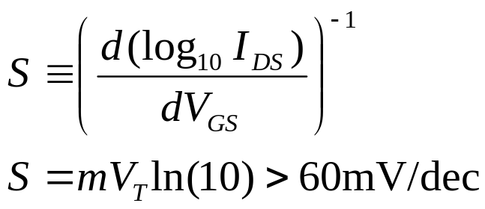
Sub-Threshold Leakage Current
Recall that, in the depletion (sub-threshold) region of operation, the channel potential is capacitively coupled to the gate potential. A change in gate voltage (ΔV_{GS}) results in a change in channel voltage (ΔV_{CS}):
Therefore, the sub-threshold current (I_{D,subth}) decreases exponentially with linearly decreasing V_{GS}/m
I_{D}
log (I_{D})
“Sub-threshold swing”:
V_{GS}
V_{GS}

Slide 12
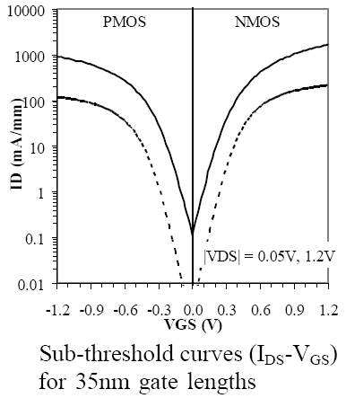
Short-Channel MOSFET I_{D}-V_{GS}
P. Bai et al. (Intel Corp.),
Int’l Electron Devices Meeting, 2004.

Slide 13
V_{TH} Design Trade-Off
Low V_{TH} is desirable for high ON-state current:
I_{D,sat} ∝ (V_{DD} - V_{TH})^{η} 1 < η < 2
But high V_{TH} is needed for low OFF-state current:
log I_{D}
Low V_{TH}
V_{TH} cannot be reduced aggressively.
High V_{TH}
I_{OFF,low VTH}
I_{OFF,high VTH}
V_{GS}
0

Slide 14
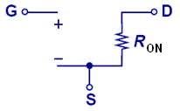
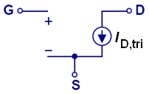
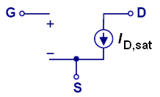
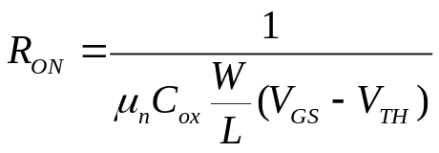
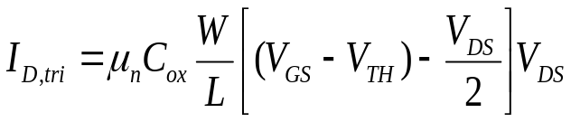
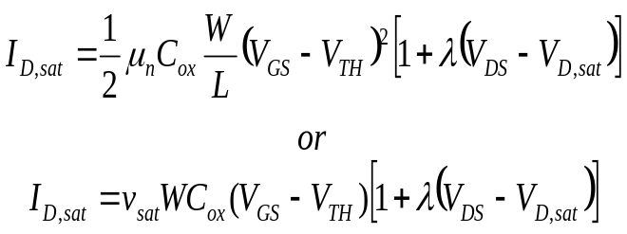
MOSFET Large-Signal Models (V_{GS} > V_{TH})
Depending on the value of V_{DS}, the MOSFET can be represented with different large-signal models.
V_{DS} << 2(V_{GS}-V_{TH})
V_{DS} < V_{D,sat}
V_{DS} > V_{D,sat}

Slide 15
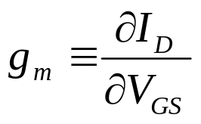
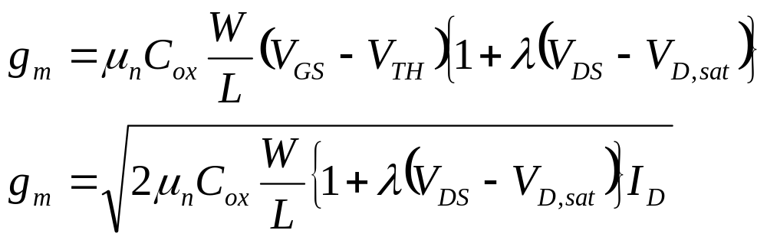
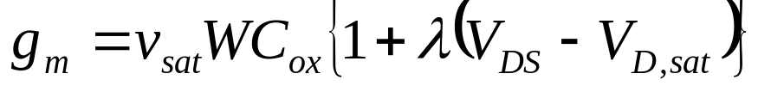
MOSFET Transconductance, g_{m}
Transconductance (g_{m}) is a measure of how much the drain current changes when the gate voltage changes.
For amplifier applications, the MOSFET is usually operating in the saturation region.
  For a long-channel MOSFET:
  For a short-channel MOSFET:

Slide 16
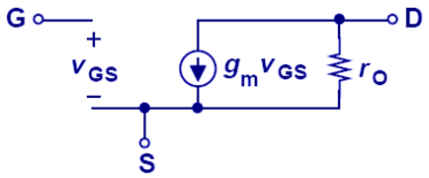
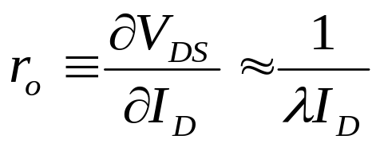
MOSFET Small-Signal Model (Saturation Region of Operation)
The effect of channel-length modulation or DIBL (which cause I_{D} to increase linearly with V_{DS}) is modeled by the transistor output resistance, r_{o}.

Slide 17
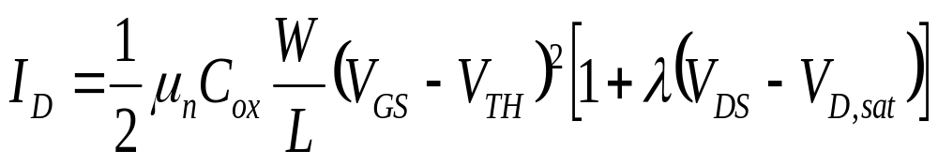
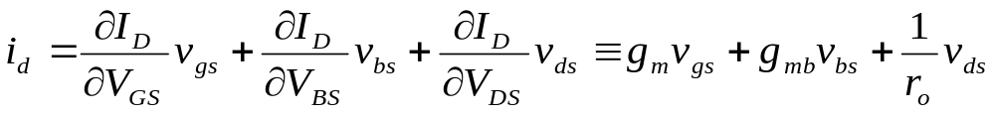
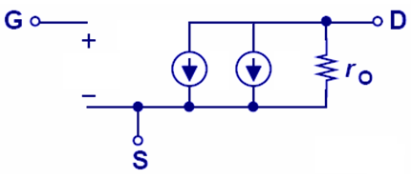
Derivation of Small-Signal Model (Long-Channel MOSFET, Saturation Region)

Slide 18
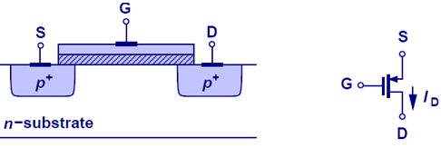
PMOS Transistor
A p-channel MOSFET behaves similarly to an n-channel MOSFET, except the polarities for I_{D} and V_{GS} are reversed.
The small-signal model for a PMOSFET is the same as that for an NMOSFET.
  The values of g_{m} and r_{o} will be different for a PMOSFET vs. an NMOSFET, since mobility & saturation velocity are different for holes vs. electrons.
Schematic cross-section
Circuit symbol

Slide 19
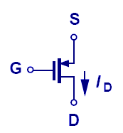
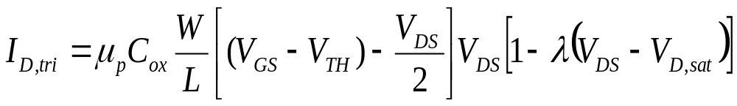
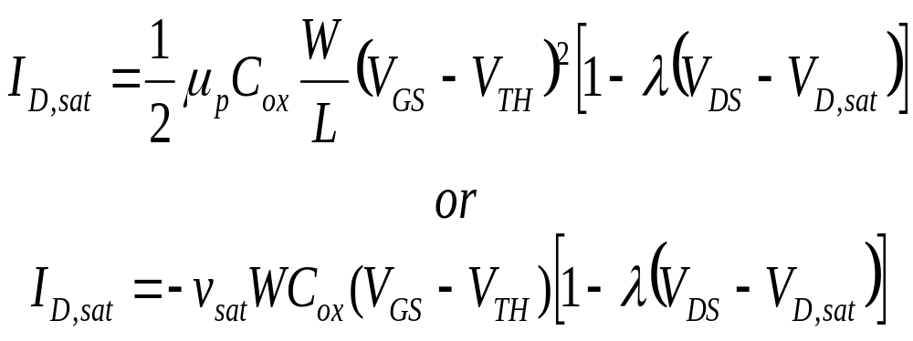
PMOS I-V Equations
For |V_{DS}| < |V_{D,sat}|:
For |V_{DS}| > |V_{D,sat}|:
for long channel
for short channel

Slide 20
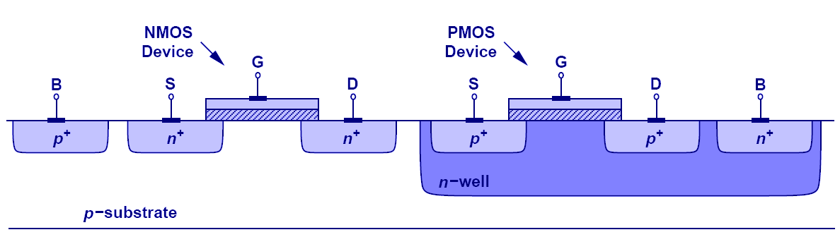
CMOS Technology
It possible to form deep n-type regions (“well”) within a p-type substrate to allow PMOSFETs and NMOSFETs to be co-fabricated on a single substrate.
This is referred to as CMOS (“Complementary MOS”) technology.
Schematic cross-section of CMOS devices

Slide 21
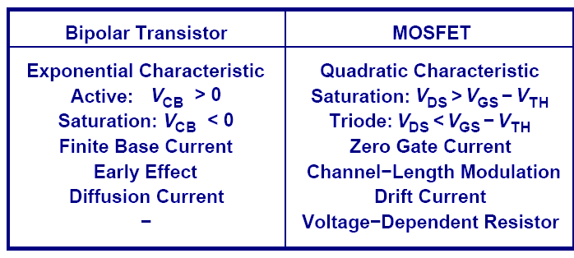
Comparison of BJT and MOSFET
The BJT can achieve much higher g_{m} than a MOSFET, for a given bias current, due to its exponential I-V characteristic.

